Slide 1
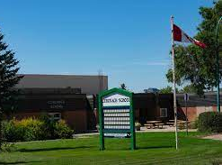
Coronach School Course Registration
2021-2022

Slide 2
Saskatchewan High School Credit Options A guide for High School Students
In Saskatchewan, students have to pass certain courses such as English language arts, math and science in order to graduate with a Grade 12 program standing. Students must successfully complete and pass 24 course credits. At the secondary level, there are three categories in which students must obtain credits:
• required courses of study which are compulsory courses intended to provide a general education;
• specified areas of study which are intended to allow students to continue to take courses of a general nature or to specialize in areas of individual interest; and,
• electives which allow for further choice and specialization based on individual needs and local priorities

Slide 3
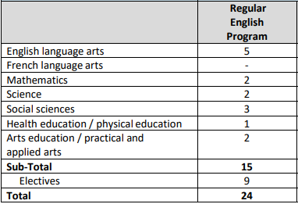
The table provides an overview of what you need to graduate:

Slide 4
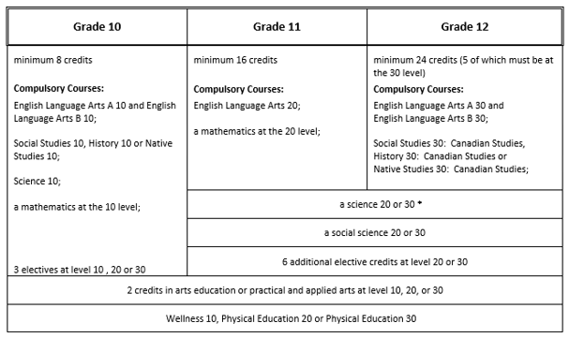

Slide 5
Prairie South Credit Tracking Form

Slide 6
Types of Programming Grade 10-11-12
Regular (10, 20, 30)
Modified (11, 21, 31)
Alternate (18, 28, 38)
Functionally Integrated

Slide 7
Parent/Guardian Awareness of Programming for Modified, Alternate, and Functionally Integrated Programs

Slide 8
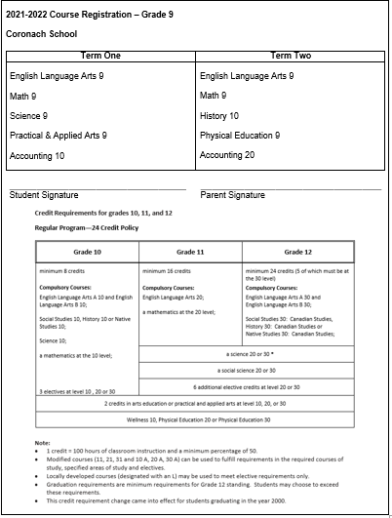
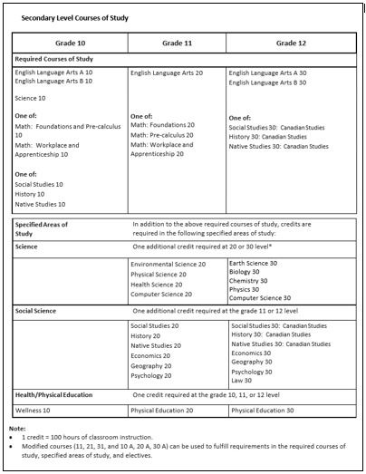
Coronach School Registration Forms Gr 9-12

Slide 9
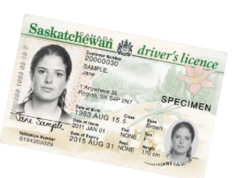
Drivers Education
Anyone wanting to acquire a Saskatchewan Class 5 driver’s license is required to take driver education from an SGI-certified driver educator. Students must be at least 14 years, 9 months of age to register. After-school classes will be offered throughout the school year. The course consists of 30 hours of classroom followed by in-car instruction (in car is done during school hours and on weekends for city trip – Moose Jaw).
Eligibility Requirements:
Be 15 years of age by the start date of program
Have a Saskatchewan Government MySGI account and a customer number from any SGI agency (documents accepted are a valid health card and a birth certificate, passport, or treaty card).
Have the ability to practice at home during the program

Slide 10
Spares
Grade 10 – 0 spares allowed
Grade 11 – 0 spares allowed
Grade 12 – unlimited spares allowed
Note: Students participating in extra-curricular sports and activities need to be considered full time students – i.e.: taking 3 or more classes a semester.

Slide 11
English Language Arts
Grade 10
ELA A10
ELA B10
Grade 11
ELA 20
Communications Studies 20, Creative Writing 20, Journalism Studies 20, Media Studies 20 *elective course
Grade 12
ELA A30
ELA B30

Slide 12
Mathematics
Grade 10
Workplace and Apprenticeship 10
Foundations of Mathematics and Pre-Calculus 10
Grade 11
Workplace and Apprenticeship 20
Foundations of Mathematics 20
Pre-Calculus 20
Grade 12
Workplace and Apprenticeship 30
Foundations of Mathematics 30
Pre-Calculus 30
Calculus 30 - On-line

Slide 13
Mathematics

Slide 14
Workplace and Apprenticeship Math 10
Workplace and Apprenticeship Math 10-Content is designed to provide students with the mathematical knowledge, skills and understandings needed for entry into trade-related courses and for direct entry into the work force.
This course is the pre-requisite for Workplace and Apprenticeship 20. It focuses on both the metric and imperial systems of measurement. Concepts include area of 2-D shapes and 3-D objects, games involving spatial reasoning, the Pythagorean Theorem, polygons, and an introduction to trigonometry ratios (sine, cosine and tangent), angles, pricing and currency exchange, and income. The seven units covered are:
Unit Pricing and Currency Exchange; Earning an Income; Length, Area and Volume; Mass, Temperature and Volume; Angles and Parallel Lines; Similarity of Figures; Trigonometry of Right Triangles

Slide 15
Foundations of Math and Pre-Calculus 10
Foundations of Math and Pre-Calculus 10-Content in this course will meet the needs of students interested in pursuing university or technical education. The outcomes in this course are the pre-requisite outcomes for both Foundations of Math and Pre-Calculus courses.
This course is the pre-requisite for both the Foundations Math and the Pre-Calculus at the Grade 11 level. It introduces and focuses on the following concepts:
Factoring, rational and irrational numbers, laws of exponents, operations with polynomials, trigonometry, relations and functions, slope, linear relations, graphing, linear systems, the metric system and imperial measurements

Slide 16
Workplace and Apprenticeship Math 20
Workplace and Apprenticeship Math 20-Content is designed to provide students with the mathematical knowledge, skills and understandings needed for entry into trade-related courses and for direct entry into the work force.
*Prerequisite* – Workplace & Apprenticeship 10
This course is a pre-requisite for Workplace & Apprenticeship 30. It asks students to deepen their understanding of topics introduced in Grade 10, including surface area, volume, capacity, formulas, right triangles, 3D objects, and mathematical games involving numerical reasoning.
As well, it introduces the following topics:
Data Analysis Using a Variety of Graphs
Personal Budgeting
Compound Interest and Financial Institution Services
Slope, Including Using Technology
Unit analysis and scale

Slide 17
Foundations of Math 20
Foundations of Math 20-Content in this course will meet the needs of students interested in pursuing careers in areas that typically require university but are not math intensive, such as the humanities, fine arts, social sciences, and nursing.
*Prerequisite* – Foundations & Pre-Calculus 10
This course is a pre-requisite for Foundations of Math 30. It introduces and/or focuses on the following concepts:
Inductive/deductive reasoning, proportional reasoning, angles and triangles, sine and cosine laws, data analysis, linear inequalities and basic quadratic functions. As well, students research and present an historical mathematical event or area of interest.

Slide 18
Pre-Calculus 20
Pre-Calculus 20-Content in this course will meet the needs of students interested in pursuing careers that require university or technical education with a math intensive focus.
*Prerequisite* – Foundations & Pre-Calculus 10
This course is a pre-requisite for Pre-calculus Math 30. It introduces and/or focuses on the following concepts:
Absolute value, radical numbers, rational expressions and equations, the primary trig ratios, sine and cosine laws, factoring of polynomial expressions, quadratic functions, quadratic equations, inequalities, arithmetic and geometric sequences and series, and reciprocal functions.

Slide 19
Workplace and Apprenticeship Math 30
Work and Apprenticeship Math 30-Content is designed to provide students with the mathematical knowledge, skills and understandings needed for entry into trade-related courses and for direct entry into the work force.
*Prerequisite* – Workplace & Apprenticeship 20
This course continues the focus of its two pre-requisites on very “real world” math, including mathematics required for, but not limited to the trades. Real world applications include how to buy a vehicle, and how to set up a small business. Math concepts include:
Transformations of 2-D shapes and 3-D objects; puzzles and games involving spatial reasoning; sine and cosine laws; limitations of measuring instruments; triangles, quadrilaterals and regular polygons; linear relations; data analysis; percentiles and probability.

Slide 20
Foundations of Math 30
Foundations of Math 30-Content in this course will meet the needs of students interested in pursuing careers in areas that typically require university or technical education but are not math intensive. Examples of these include the humanities, fine arts, social sciences and nursing
*Prerequisite* – Foundations 20
This course continues the learning begun in Foundations 20 and includes the following topics:
Inductive and deductive reasoning; financial decision making; set theory and its applications; odds/probability; permutations and combinations; and lastly, logarithmic, exponential, sinusoidal and basic polynomial functions. As well, students have the opportunity to research and present a current event or area of interest using data collection and analysis.

Slide 21
Pre-Calculus 30
Pre-Calculus 30-Content in this course will meet the needs of students interested in pursuing careers that require university or technical education with a math intensive focus.
Prerequisite* – Pre-Calculus 20
This high-level math course focuses on the following concepts:
Angles; rational and radical functions; operations on and transformations of functions; trigonometric ratios, equations, functions and identities; the unit circle; logarithms; advanced polynomial functions; relations and their inverses; and finally, combinatorics (permutations, combinations and the binomial theorem).

Slide 22
Calculus 30
Calculus 30-This course is for students who intend to pursue mathematics or sciences at a post secondary institution. The course includes an in-depth study of limits, derivatives, and integration, as well as practical applications of derivatives and integration
*Prerequisite* – Pre-Calculus 30
This course is designed as an introduction to Calculus and deals with limits; slope of the tangent line; derivatives, and their application to motion, related rates, and maximum and minimum problems; and area and integration, if time permits. Calculus 30 is intended for the student who is academically strong in the field of mathematics. The six units of study covered include:
Introduction to Calculus
Slopes and Rates of Change
Derivatives and Their Properties
Application of Derivatives (Motion)
Applications of Derivatives (Area and Volume)
Area and Integration

Slide 23
Science
Grade 10
Science 10
Grade 11
Health Science 20
Environmental Science 20
Physical Science 20
Computer Science 20
Grade 12
Biology 30
Earth Science 30
Physics 30
Chemistry 30
Computer Science 30

Slide 24
Science

Slide 25
Science 10
SCIENCE 10
The Grade 10 program provides students with the introductory knowledge and skills needed for Biology, Chemistry and Physics. Topics include science topics in senior science courses, consequence of human actions, mechanisms influencing climate, biodiversity, biogeochemical cycles, chemical reactions, energy change, chemical formulas, conservation of mass, reaction rate, speed, acceleration, force and motion. There is some laboratory work which will aid in the development and understanding of the theory presented. The units of study are:
Career Education
Student-Directed Study
Force and Motion in Our World
Chemical Reactions
Climate and Ecosystem Dynamics

Slide 26
Health Science 20
HEALTH SCIENCES 20
*Pre-requisite* - Science 10
This course will challenge students to look at the health science field from holistic and analytic perspectives to provide a basis for making sound personal health choices. Students will examine the range of philosophies that guide health care and consider ethical decision within those contexts. Understanding the basic anatomy and physiology of the human body will provide a context for studying the normal and abnormal functioning of various body systems, including the role of nutrition and metabolism. Lastly, students will examine diagnostic tools and procedures and how they are used to inform treatment. Students will also investigate the range of health science careers and post-secondary programs available in Saskatchewan. Units of study include:
Unit One: Health Care Philosophies and Ethics
Unit Two: Human body
Unit Three: Nutrition
Unit Four: Diagnostics and Treatment
Unit Five: Career Exploration
Unit Six: Student-Directed Study

Slide 27
Environmental Science 20
ENVIRONMENTAL SCIENCE 20
*Prerequisite* –Science 10
Students will learn how to examine local and global environmental issues such as climate change, water, soil, and air quality, urbanization, bio resource management, waste handling and disposal, land-use planning, and the impacts of agriculture and industry on the environment from scientific and Indigenous knowledge perspectives. Students will examine the role of environmental policies and ethics on decision making, and will investigate environmental science related careers. Student directed studies will lead to the development of environmental action plans. The units are
Unit One: Career Exploration
Unit Two: Student-Directed Study
Unit Three: Integrative Nature of Environmental Science
Unit Four: Atmospheric Systems
Unit Five: Human Population
Unit Six: Aquatic Systems
Unit Seven: Terrestrial Ecosystems

Slide 28
Physical Science 20
PHYSICAL SCIENCE 20
*Prerequisite* – Science 10
This course combines chemistry and physics in an integrated manner to investigate concepts related to heating and cooling, the foundations of chemistry, including the mole and quantitative analysis of molecules and chemical reactions, and the characteristics and properties of waves. An overarching theme is the study of the enterprise of public and private science as it occurs in agriculture, industry, and universities to help students better understand various physical science related career paths. Student inquiry will guide independent investigations of physical science phenomena. The units are:
Unit One: Career Exploration
Unit Two: Student-Directed Study
Unit Three: Heat
Unit Four: Foundations of Chemistry
Unit Five: Properties of Waves

Slide 29
Computer Science 20
COMPUTER SCIENCE 20
*Prerequisite* – Science 10
Fundamental programming skills will be developed with a focus on computer system components, problem-solving methods, computer program writing, software design, interpreting and writing documentation and network systems. There will be a career investigation and a research project. The units that are covered include:
Unit One: Software and Hardware
Unit Two: Problem Solving
Unit Three: Fundamentals of Programming and Design
Unit Four: Experience With Program and Design
Unit Five: Networks
Unit Six: Careers Related to Computer Science
Unit Seven: Research Topics
Computer Programmers create apps, programs, video games and other software

Slide 30
Biology 30
BIOLOGY 30
*Prerequisite* –Health Science 20 or Environmental Science 20
In Biology 30 students will gain experiences which allow them to see the connections between the theory of evolution and the understandings of life characteristics. Cellular structure and function will be examined, as well as biological classification to demonstrate relationships between organisms. Classic and modern genetics will be studied, illustrating their effect on life understandings and biotechnology. A student-led topic study will also be included in the course. The four units covered include:
Unit One: Student-Directed Study
Unit Two: Life and Evolution
Unit Three: Organization of Life
Unit Four: Genetics and Biotechnology

Slide 31
Earth Science 30
EARTH SCIENCE 30
*Prerequisite* - Physical Science 20 or Environmental Science 20
Students will examine our planet’s geology origins (rocks, minerals, natural resources) and the geological timescale as a foundation to guide decision making with regard to the use of its mineral and energy resources, the maintenance and remediation of the environment, and response to geological hazards. Hands-on field experiences will enable students to develop visual-spatial reasoning skills and an understanding of the role of Geographic Information Systems. Students will also explore the historical and contemporary significance of Earth Science and related careers. The units of study are:
Unit One: Student-Directed Study
Unit Two: Career Exploration
Unit Three: Foundations of Earth Science
Unit Four: Lithosphere
Unit 5: Atmosphere and Hydrosphere

Slide 32
Physics 30
PHYSICS 30
*Prerequisite* – Physical Science 20
Physics 30 includes topics and activities relating to quantum mechanics, radioactivity and nuclear technology, motion in one and two-dimensions, the effect of forces on motion, and how momentum and energy relate to objects and systems. Gravitational, electrical and magnetic fields will also be studied. Students will also conduct an in-depth study on a topic of interest in the course. The units covered include:
Unit One: Student-Directed Study
Unit Two: Modern Physics
Unit Three: Forces and Motion
Unit Four: Conservation Laws
Unit Five: Fields

Slide 33
Chemistry 30
CHEMISTRY 30
*Prerequisite* – Physical Science 20
This course examines some advanced principles of physical chemistry. It includes the study of how electrons influence chemical bonding and chemical properties, organic compounds, practical uses of compounds base on their properties, and equilibrium systems. Study also includes electrochemical applications and oxidation-reduction reactions. A student-directed topic study related to personal interest will be completed during the course. The four units covered include:
Unit One: Student-Directed Study
Unit Two: Chemical Bonding and Materials Science
Unit Three: Chemical Equilibria
Unit Four: Electrochemistry

Slide 34
Computer Science 30
COMPUTER SCIENCE 30
*Prerequisite* – Computer Science 20
Computer Science 30 is an advanced course in programming. This class expands on the Software and Hardware, Problem Solving, and Experience with Programming and Design units in Computer Science 20. Also included are study of numbers systems and codes in computer processing, application programming, the Internet and multimedia, and the impact of informational technology on society. The units that are covered include:
Unit One: Software and Hardware Advanced
Unit Two: Problem Solving- Advanced
Unit Three: Problem Solving and Programming
Unit Four: Experience with Programming and Design- Advanced
Unit Five: Number Systems and codes
Unit Six: Impact of Information Technology
Unit Seven: Programming for Applications
Unit Eight: Internet and Multimedia

Slide 35
Social Studies
Grade 10
History 10, Social Studies 10, Native Studies 30
Grade 11
History 20, Social Studies 20, Social Studies 30
Psychology 20, Geography 20, Economics 20
Grade 12
History 30, Social Studies 30, Native Studies 30
Psychology 30, Geography 30, Economics 30, Law 30

Slide 36
Social Studies Descriptions
History 20 – This course helps students understand the major issues facing humanity at the end of the twentieth century. The course examines the conditions, ideas, and events of the twentieth century which gave rise to these issues. World War I, World War II, Cold War
History 30 - This course helps students understand the major issues facing Canadians at the end of the twentieth century. The course examines the historical forces between the Aboriginal peoples who have always been here and the many different immigrants who came to make a new life for themselves. War of 1812, development of Medicare, FLQ Crisis of 1970s.
Native Studies 20– This course will help all students develop their knowledge, positive attitudes and cultural understanding about First Nations, Métis and Inuit peoples from a World Issue perspective. The course focuses on Self Determination and Self-Governance, Development and Social Justice.
Native Studies 30– This course will help all students develop their knowledge, positive attitudes and cultural understanding about First Nations, Métis and Inuit peoples from a Canadian perspective. The course focuses on Aboriginal and Treaty Rights, Governance, Land Claims and Treaty Land Entitlements, Economic Development and Social Development. Life prior to the arrival of Europeans, residential schools, missing and murdered Indigenous women.
Social Studies 20 – This course helps students understand the major issues facing humanity at the end of the twentieth century. The course examines issues such as human rights, population growth, wealth creation, environmental change, and world governance.
Social Studies 30 – This course helps students understand the major issues facing Canadians at the end of the twentieth century. The course examines issues such as social change throughout Canadian history, people-land relationships, cross-cultural relationships, the governance of Canadian society, and Canada's relationship with the global community. Canadian governance, relationships between Canadians and the land.
Psychology 20/30-Students will study human development from conception, pregnancy, birth, infancy, childhood, adolescence and adulthood.
Law 30-Students will become active, informed and productive citizens who know and understand their legal rights and responsibilities.

Slide 37
Health and Physical Education
Grade 10
Wellness 10
Grade 11
Physical Education 20, Outdoor Education 20
Grade 12
Physical Education 30

Slide 38
Health & Physical Education Descriptions
Wellness 10- develops confident and competent students who understand, appreciate, and engage in a balanced, healthy, and active lifestyle. Units include Understanding Wellness, Service Learning, Movement, Mental Well-Being, Self Awareness and Self-Management, Culture of Safety and Physical Fitness
Physical Education 20/30 are courses where students learn about the importance of physical activity through development of fitness action plans, motor skill activities, movement patterns and volunteer work. Areas of focus are aquatics, developmental games and sports, educational gymnastics, fitness, outdoor pursuits and rhythmics/dance.

Slide 39
Electives we have typically offered in the past
Arts Education 30
PAA A10, A20, A30
Career and Work Exploration 10, Career and Work Explortion A30
Accounting 10, 20

Slide 40
Electives we suggest can be offered
Life Transitions 20, 30
Financial Literacy 20, 30
Entrepreneurship 30
Health Science 20
Arts Education 10, 20
Psychology 20, 30
Law 30

Slide 41
Elective Descriptions
Life Transitions 20/30 - Students will develop the knowledge, skills and abilities to plan and enhance their personal health, family life, community life, and career development. You’ve graduated and now how do you survive? Life Transitions 30 takes a look at everything for you to be independent and not to move back in with your parents. Learn how to budget, handle conflict, manage health care, get a job and balance family dynamics
Financial Literacy 20/30 - The purpose of this course is to provide high school students with basic skills in financial literacy; help them develop an awareness and understanding of personal finance and personal economic decision making; teach them to respond to business decisions as informed consumers; and provide them with a broad base of knowledge and skills related to personal financial management. The units of study are listed below: Economics of Personal Finance; Decision Making and Money Basics; Banking Services; Income and Taxation; Budgeting; Savings and Investing; Credit and Credit Cards; Consumer Protection; Renting, Leasing, and Buying.
Entrepreneurship 30 – This course provides students with a hands-on learning opportunity where they will run their own business. Students invest their own money into the company, produce and sell a product, and receive a financial return if they are profitable. This is a great opportunity to learns the ins and outs of running your own business!

Slide 42
Prairie South School Division Virtual School Courses

Slide 43
Conclusion
To access this presentation please go to:
Coronach School Website: https://schools.prairiesouth.ca/coronach/
Click High School Course Information

